Slide 1
Feature Selection

Slide 2
Topics Covered
Feature Selection
Different methods of feature selection
Example

Slide 3
What is Feature Selection?
Feature selection means selecting and retaining only the most important features in the model.
Feature selection is different from feature extraction.
Extraction: create a new feature from the existing features.
  Principal Component Analysis (PCA) technique to reduce the dimensionality and eliminate redundancy
Selection: choosing a subset of the original pool of features.

Slide 4
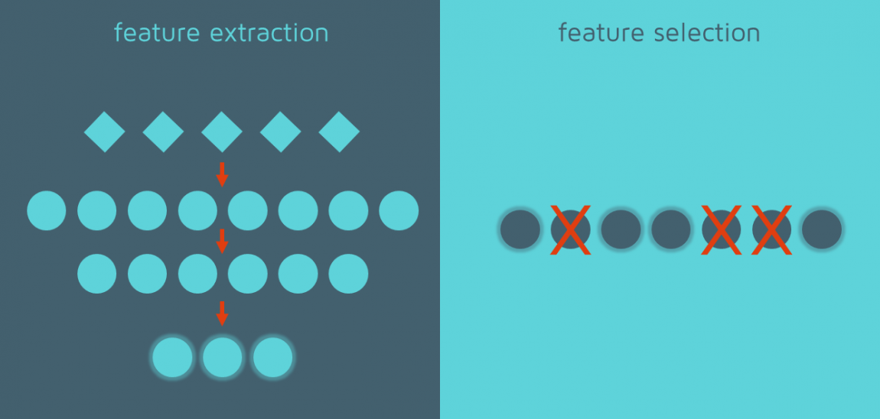

Slide 5
Feature selection
Given a set of potential features, select some of them and discard the rest.
Feature selection is applied to remove irrelevant and/or redundant features, reduce overfitting, and simplify the model..
User ID | Gender | Age | EstimatedSalary | Purchased
15624510 | Male | 19 | 19000 | 0
15810944 | Male | 35 | 20000 | 0
15668575 | Female | 26 | 43000 | 1
15603246 | Female | 27 | 57000 | 0
15804002 | Male | 19 | 76000 | 1

Slide 6
When should we apply feature extraction and selection?
Feature extraction:
Feature extraction is always needed for ML models.
We wouldn’t need any feature extraction in deep learning neural networks (our algorithm can perform feature extraction by itself).
Feature selection:
Apply feature selection when there is a redundancy or irrelevancy in dataset, since these affect the model accuracy or simply add noise.
Feature selection may be performed only to reduce the number of features, in order to favor computing feasibility.

Slide 7
Filter Methods
Filter methods are generally used as a preprocessing step.
The selection of features is independent of any machine learning algorithms.
Features are selected based on their scores in various statistical tests for their correlation with the outcome variable.
Set of all features
Selecting the best subset
Apply learning algorithm
Measure performance
Examples:
  Correlation
  Chi-square test
  Information gain

Slide 8
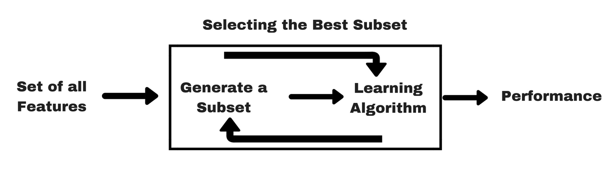
Wrapper Methods
A wrapper evaluates a specific model sequentially using different subsets of features to get the best subset.
They are highly costly and have a high chance of overfitting, but also a high chance of success, on the other hand.

Slide 9
Wrapper Methods
These methods are usually computationally very expensive.
Examples of wrapper methods are
  Forward feature selection
  Backward feature elimination
  Recursive feature elimination

Slide 10
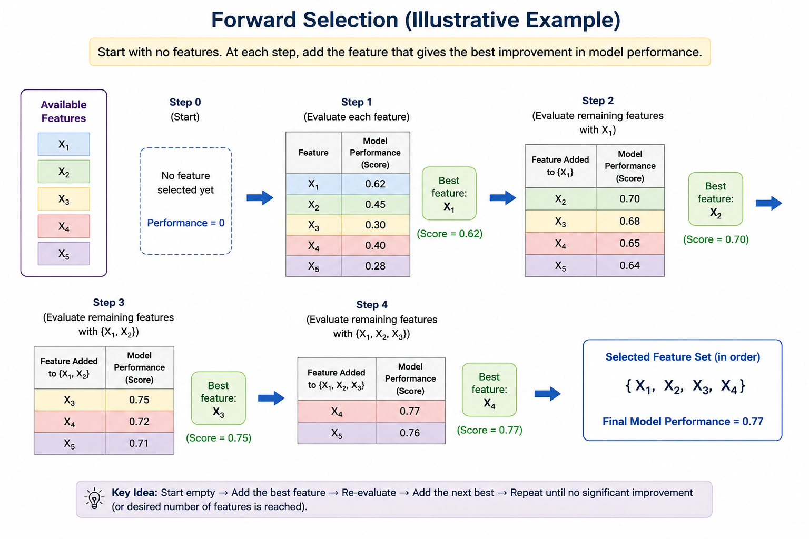
Forward Selection
It begins with an empty set of features and iteratively adds the feature that provides the most significant improvement to the model's performance until a stopping criterion is met.

Slide 11
Backward Elimination
Backward elimination is used in machine learning to build a more efficient model by removing features that are not statistically significant.
The process starts with all features and iteratively removes the one with the highest p-value until only significant features remain.

Slide 12
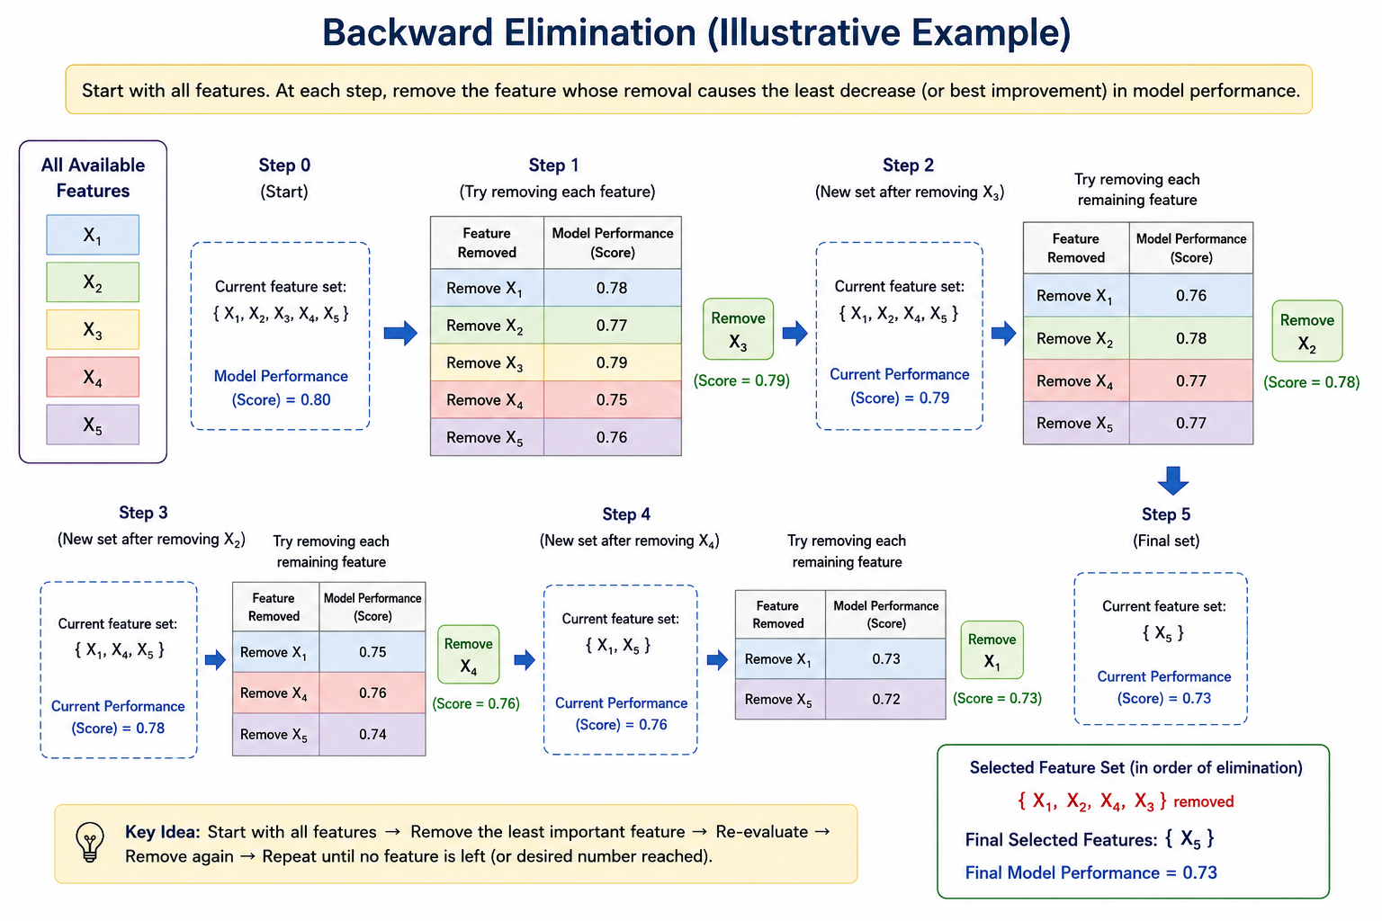

Slide 13
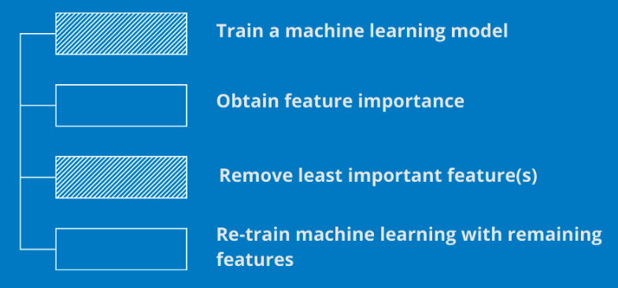
Recursive Feature Elimination

Slide 14
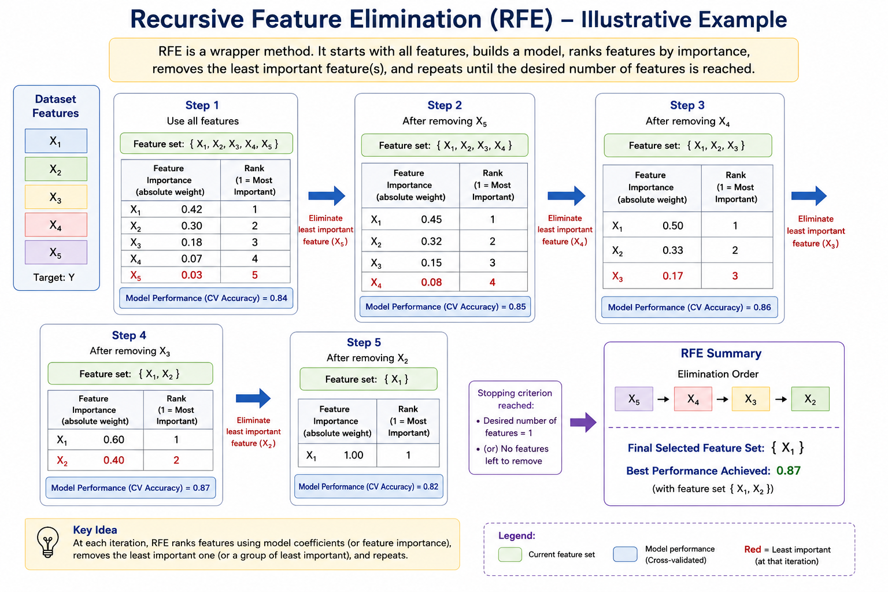

Slide 15
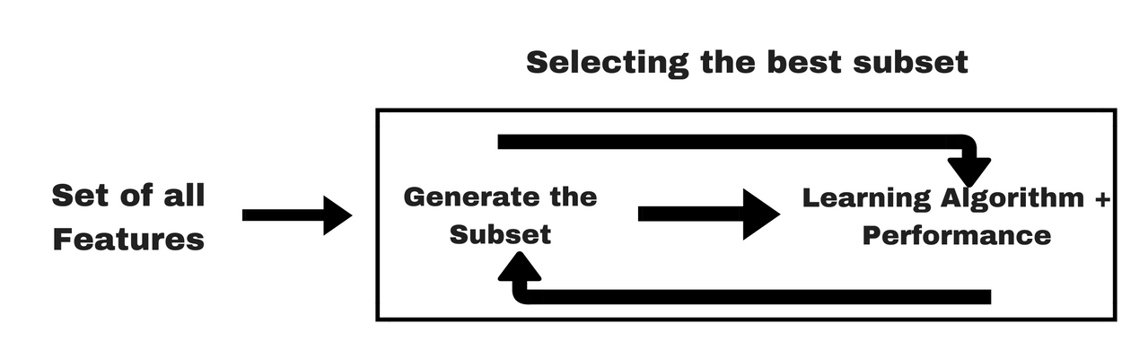
Embedded Methods
Embedded methods combine the qualities of filter and wrapper methods.
It’s implemented by algorithms that have their own built-in feature selection methods.

Slide 16
Thank you

